Slide 1
“Overview of IUH Workspace- Replacing Cerner Home Remote”
IU Health Research Access Team

Slide 2
Agenda
What is happening?
Who is impacted?
When is it happening?
Troubleshooting Resources
  OCR Website
  Help Desks
Questions

Slide 3
What and When and Who?
Cerner Remote Access Workflow is moving from Cerner Home Remote to IUH Workspace.
Impacts anyone using Cerner Home Remote to access Cerner
  Monitors, outside auditors, personal computers, non-IUSOM work computers
Does not impact IU Health computers or IUSOM staff using the Cerner shortcut on their IUSOM computer
June 23, 2020

Slide 4
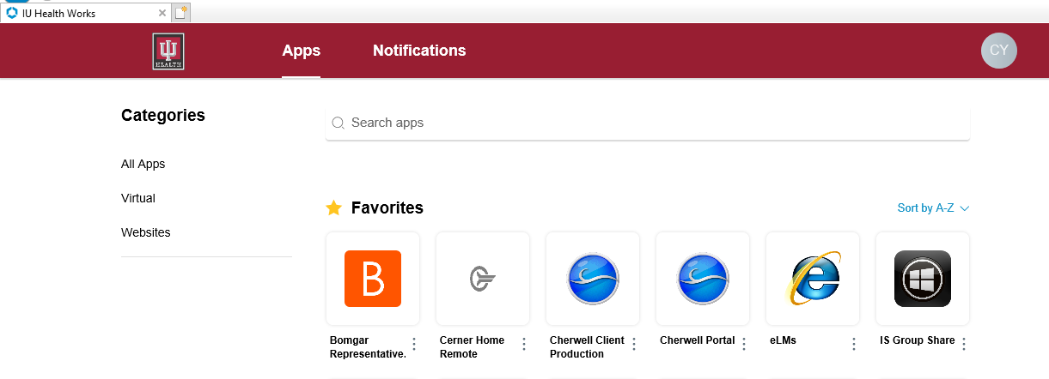
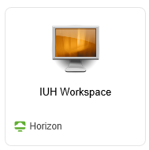

How do I access IUH Workspace?
Works Web is the IU Health web interface used for launching Cerner via Horizon VM Ware
Navigate to https://works.iuhealth.org in the internet browser.
Sign in using the IU Health user name and password provided.
Perform Duo authentication. (IU DUO users will need a separate IU Health DUO account.)
Click on IUH Workspace icon.
Open the Cerner Apps folder and click on the PowerChart PROD shortcut.

Slide 5
What do I need to use IUH Workspace?
Internet Browser
IU Health DUO account
Horizon VMWare downloaded on the computer
  Please note that some individuals may not have admin rights to download software on their work computers. You will have to contact the help desk supporting the computer to have them download the software for you.

Slide 6

How do I get to my desktop or use multiple monitors?
Minimize or ”window” IUH Workspace desktop
Multiple Monitors
    Once your virtual desktop is in windowed mode, your local desktop will be revealed. From your local system tray (bottom right corner), right click the VMware Horizon Client icon and click Settings.
    From the settings menu, pictured below, select IUH Workspace (left bar). In Display Settings select which monitors you’d like to use for your virtual desktop (they should turn green), then click Apply. Your desktop will now use only the selected monitors when full screened.
    FAQ with full illustrated instructions is available under Cerner Remote Access on the OCR website

Slide 7
Trouble Shooting Resources
IU UITS Help desk for IUSOM Cerner shortcut
Office of Clinical Research Website
https://ocr.iu.edu/iu-health-access/
Remote Access

