Slide 1
Research Overview
PowerTrials and Systems
Related Research Processes at
IU Health

Slide 2
Topics
Clinical Research at IU Health
OnCore, PowerTrials, and PowerChart
OnCore RPE to PowerTrials Process Overview
Enrollment Notes
Diagnotes
Research Order Sets
Research Opt Out
Feasibility and Subject Recruitment
REDCap

Slide 3
CLINICAL RESEARCH AT IU HEALTH

Slide 4
IU Health System
IU Health Mission:
To improve the health of our patients and community through innovation and excellence in care, education, research and service.
16 Hospitals statewide
More than 38,000 team members statewide
2,717 staffed beds
111,689 Admissions
1.2 million individual served
Over $460m in research funding
More than 1300 active research studies

Slide 5
Strategic Research Partners
Our partnership with Indiana University School of Medicine positions Indiana University Health as a leader in research bringing the latest breakthroughs from the bench to the bedside. Our goal is to improve patients’ lives by conducting clinical and outcomes-based research aimed at improving patient care and providing the most cutting-edge treatments available.
Electronic Medical Record-
Oracle Cerner
Clinical Trial Management System- OnCore

Slide 6
Key Research systems:
OnCore, PowerTrials, and Powerchart

Slide 7
OnCore® Enterprise Research
A comprehensive clinical research management system (CRMS) developed by Advarra (formerly Forte) Research Systems, Inc., OnCore ® Enterprise Research supports operations at academic medical centers, cancer centers, and health care systems.
Contracted by Indiana University School of Medicine
  Source of truth for protocol and study subject information.
  Support Team: oncore @iupui.edu or 317.278.2600
Goals:
  Increase Efficiency and Communication
  Increase Regulatory Compliance
  Manage Financials
  Provide multi level reporting and research portfolio review
  Manage multicenter studies
  Provide secure method for data management

Slide 8
Cerner PowerTrials™ Overview
Component of Cerner’s Research Solution; only component IU Health is currently utilizing
Contracted through Indiana University Health
Cerner PowerTrials consists of two applications that receive protocol and subject information from OnCore via an interface called the RPE
Goals:
  Improve Patient Safety
  Identification of research participants in PowerChart
  Cerner Message Center notifications for subject encounters
  Enhance recruitment with PowerTrials Pre Screening

Slide 9
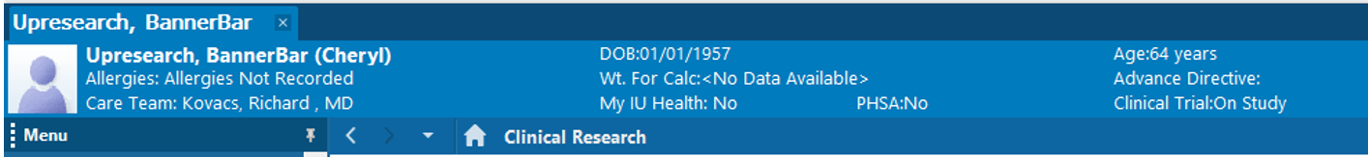
Cerner PowerChart™ Overview
Cerner PowerChart is the registration and electronic medical record (EMR) system utilized at all IU Health inpatient and outpatient health care facilities and most physician practices in the IU Health system.
Protocol and subject information in PowerChart is populated by PowerTrials
Shows subject’s participation and study status

Slide 10
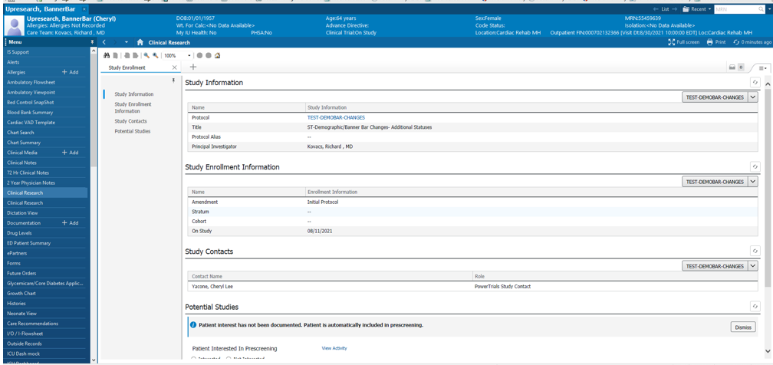
PowerChart- Clinical Research Band
Additional details about the subject's study participation can be found in the Clinical Research Band

Slide 11
PowerChart- Messages to Study Coordinators
Individuals listed as PowerTrials Study Contacts in OnCore and PowerTrials receive messages in Cerner message center when subjects in their study have been admitted to any IU Health facility for an inpatient, outpatient, clinic, observation, or ED visit.

Slide 12
OnCore to PowerTrials Process Flow

Slide 13
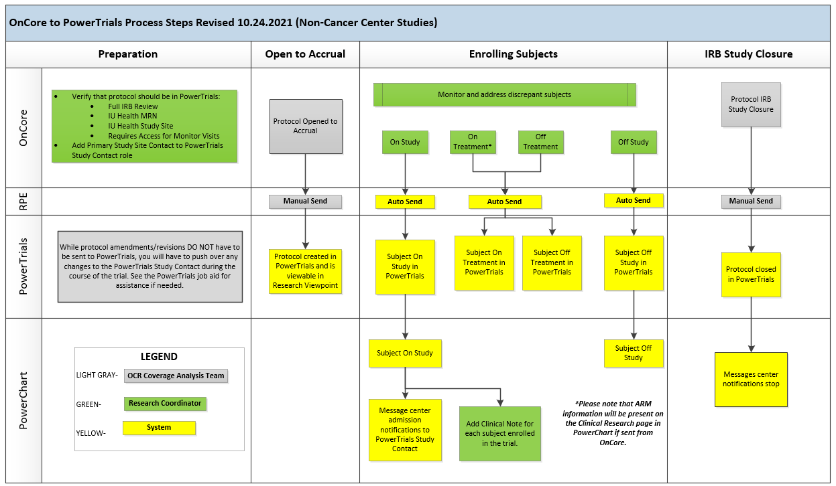
Overview of Process Flow

Slide 14
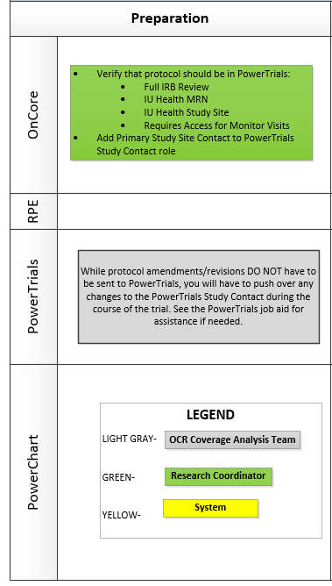
Preparation- CAT Team
Does the study need to be in PowerTrials?
  Full or Deferred IRB Review
  IU Health Study Site
  Individual subject enrollment using an IU Health MRN
*OR*
  Will have a study monitor who needs access to EMR to check source documentation
Add PowerTrials Study Contact for messages

Slide 15
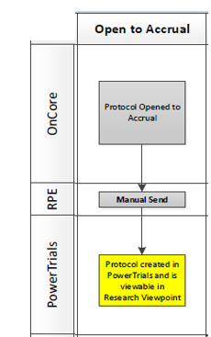
Open to Accrual Push
Coverage analysis team (CAT) (regulatory team for cancer center studies) uses the RPE push to manually create the protocol in PowerTrials

Slide 16
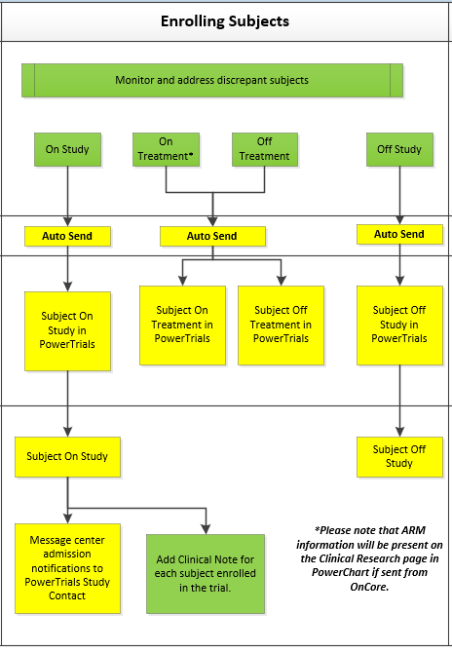
Enrolling Subjects
Subjects automatically sent to PowerTrials when enrolled on study, placed on or off treatment and at off study.
If study treatment arm information is available in OnCore, it will be sent to PowerTrials
Message Center notifications begin at on study status
Research Coordinator periodically review subjects automatically being sent to PowerTrials for any subjects that failed to successfully cross into PowerTrials (discrepant)
Policy requires enrollment note in PowerTrials

Slide 17
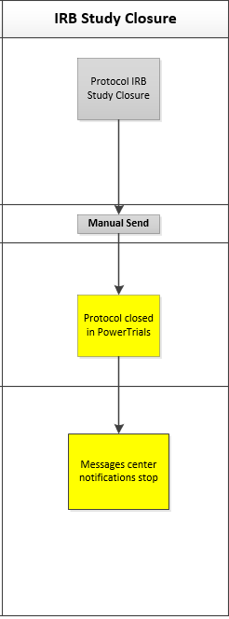
Closing Study- CAT
CAT/regulatory team uses the RPE push to manually close the protocol in PowerTrials at IRB Study Closure
If the study status is updated to IRB closure by the coordinator in OnCore, they are expected to push that closure to PowerTrials or notify the CAT team so they can do the push.

Slide 18
Summary of PowerTrials Related Coordinator Responsibilities
Follow OnCore Requirements for protocol and subject entry/updates in OnCore
Research Coordinators enter a clinical research enrollment note in PowerChart for each study subject (see FAQ)
Research Coordinator periodically review subjects automatically being sent to PowerTrials for any subjects that failed to successfully cross into PowerTrials (discrepant) (see Job Aid)
Changes to the PowerTrials Study Contacts must be entered in OnCore and manually pushed to PowerTrials (see Job Aid)

Slide 19
PowerTrials Study Contact Updates
Make updates to PowerTrials Study Contact role in OnCore
Open RPE Console
  Menu
    Admin
      Other Admin
        RPE Console
          Protocols section
Enter Protocol No. and click on the Search button
Send the protocol change to PowerTrials by checking the box and pushing “Send”
See job aid for details

Slide 20
Enrollment Clinical Notes

Slide 21
Adding a Clinical Note
Select Add Clinical Note
Select “Research/Clinical Trial Records” Type
Create Note
Modify “Associated Providers” to notify PI and other providers of subject’s enrollment based on recruitment policy
Sign

Slide 22
Enrollment Clinical Note

Slide 23
diagnotes

Slide 24
Diagnotes
Use Diagnotes for HIPAA-compliant text messaging and communication with colleagues and staff:
  ✓Native iOS and Android Application and Browser applications
  ✓Group, Automated, and Individual Messaging
  ✓Text, Voice, and Video channels of communication
  ✓Send secure photos, without saving to your phone.
  ✓Record voice recordings as messages
  ✓Upload images and files from the computer.
  ✓Live Video Chat
Additional resources can be found on the IS Clinical Education website viewable through e-coach in PowerChart.

Slide 25
Research order sets

Slide 26
Research Orders
All research services need physician orders to be considered medically necessary whether research related or standard of care.
The preferable method for order entry is for the Principal Investigator or Co-Investigator to enter orders in Cerner. May be delegated to other study staff with the appropriate training/background to safely enter orders for the PI to approve and sign.
Never use the “protocol” order communication type when placing an order
Why enter orders electronically in Cerner?
  Decrease manually transcribing the paper orders to the computer system
  Decrease the risk of error from incorrect transcription and/or order interpretation
  Decrease the risk of an order being missed by the nursing staff
To request order set build in Cerner, go to the link on the Office of Clinical Research website https://ocr.iu.edu/

Slide 27
Research Opt-Out Processes

Slide 28
Steps to Opt-Out
Once a patient lets you know that they do not want to be contacted to participate in research with IU Health
  Acknowledge request from patient
  Send Secure e-mail to ISclinicalresearchsupport@iuhealth.org
    Patient’s full name
    MRN
    DOB
IS Clinical Research Support (CRS) team will mark the patient as not interested in participating in research on the clinical research page in PowerChart

Slide 29
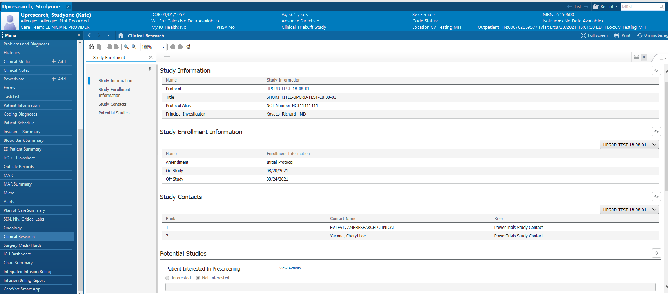
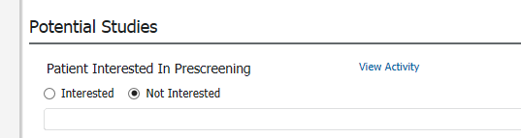
Clinical Research Page

Slide 30
Results of Opt-Out
Exclusion from PowerTrials prescreening
Exclusion from all feasibility and recruitment data requests from the Enterprise Data Warehouse
All research coordinators are expected to check the clinical research page to verify that a patient is not marked as “not interested” before approaching the patient about study participation

Slide 31
FEASIBILITY AND SUBJECT
RECRUITMENT

Slide 32
Research Recruitment Tools
Feasibility Requests
  Helps answer the question about whether there is a large enough pool of potential IU Health subjects to draw from for the study
  De-identified data only
Study Recruitment
  Data Warehouse (EDW) Queries
  PowerTrials Prescreening Rules

Slide 33
Choosing a Recruitment Tool
Data Warehouse (EDW) Queries
  One time data pull
  Data refreshed nightly
  Discrete data
  Results in Excel Spreadsheet
PowerTrials Prescreening Rules
  Study must be in PowerTrials
  Discrete data
  Research staff run the prescreening tool as often as needed
  Best for inpatient studies or studies with time sensitive or variable criteria
  Results on a Patient List in Research Viewpoint

Slide 34
How to Request Recruitment Help
Request recruitment help using the link below
  https://redcap.uits.iu.edu/surveys/?s=XNPJYNTEYD

Slide 35
redcap

Slide 36
REDCap
REDCap is a secure web platform for building and managing online databases and surveys.
REDCap provides automated export procedures for seamless data downloads to Excel and common statistical packages (SPSS, SAS, Stata, R), as well as a built-in project calendar, a scheduling module, ad hoc reporting tools, and advanced features, such as branching logic, file uploading, and calculated fields.
REDCap is preferred by IU Health systems as the methodology for storage of patient PHI
When using REDCap for storing research data containing electronic protected health information (ePHI), please note that you and the Principal Investigator (PI) are responsible for the privacy and security of these data and for compliance with any applicable federal and state laws and regulations, and institutional policies; this includes the appropriate Institutional Review Board (IRB) approvals and a Data Management Plan.
You can request a REDCap account by selecting the link below
https://redcap.uits.iu.edu

Slide 37
Resources
Subject
Primary Contact
OnCore
General IS Research Support
Recruitment/Feasibility Inquires
Training Resources
oncore@iupui.edu 317.278.2600
ISclinicalresearchsupport@iuhealth.org
clinicalresearchsystems@iuhealth.org
Office of Clinical Research
website https://ocr.iu.edu

